Slide 1

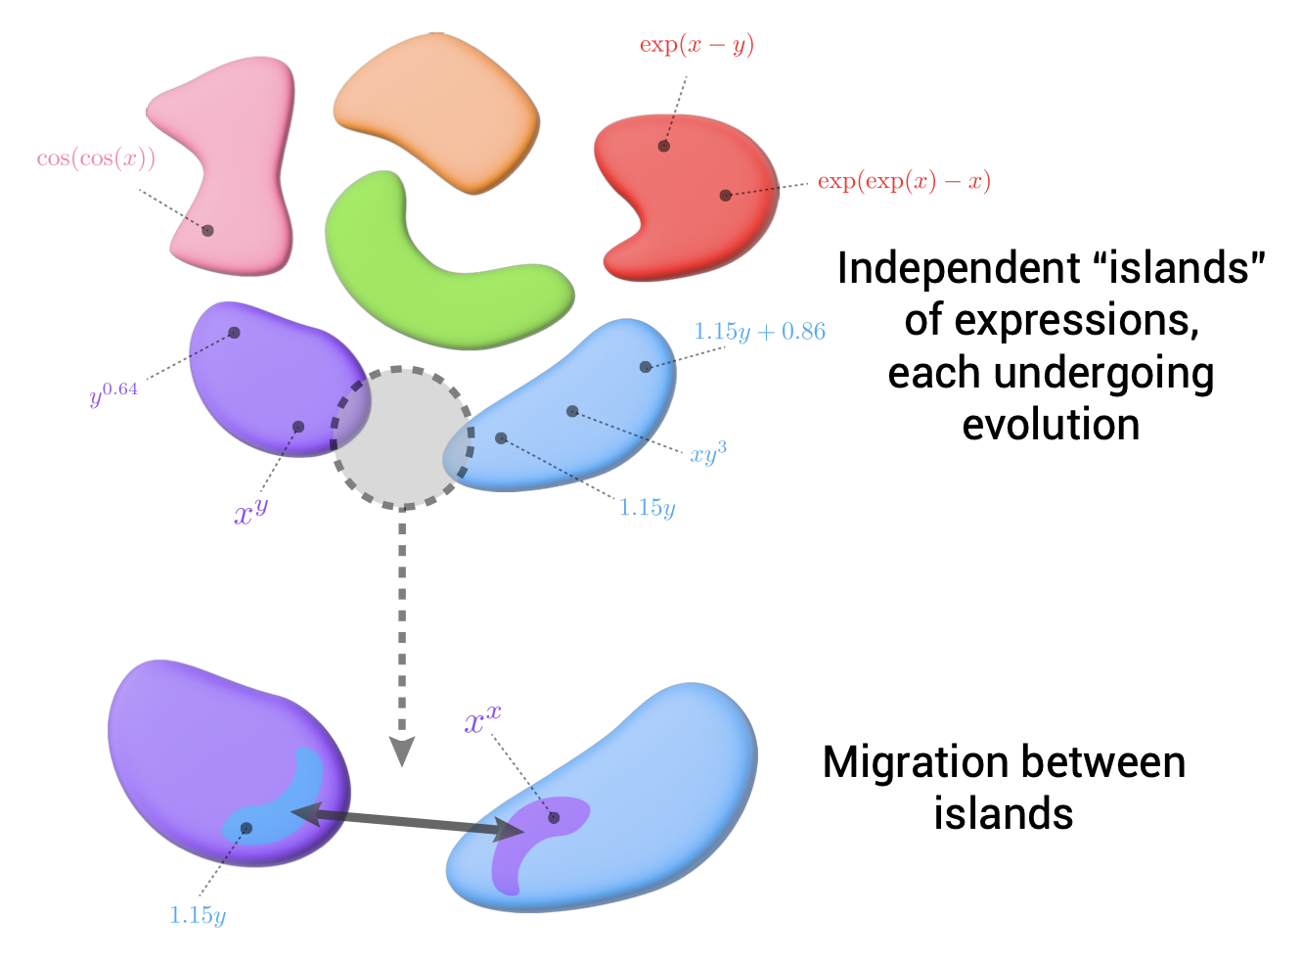

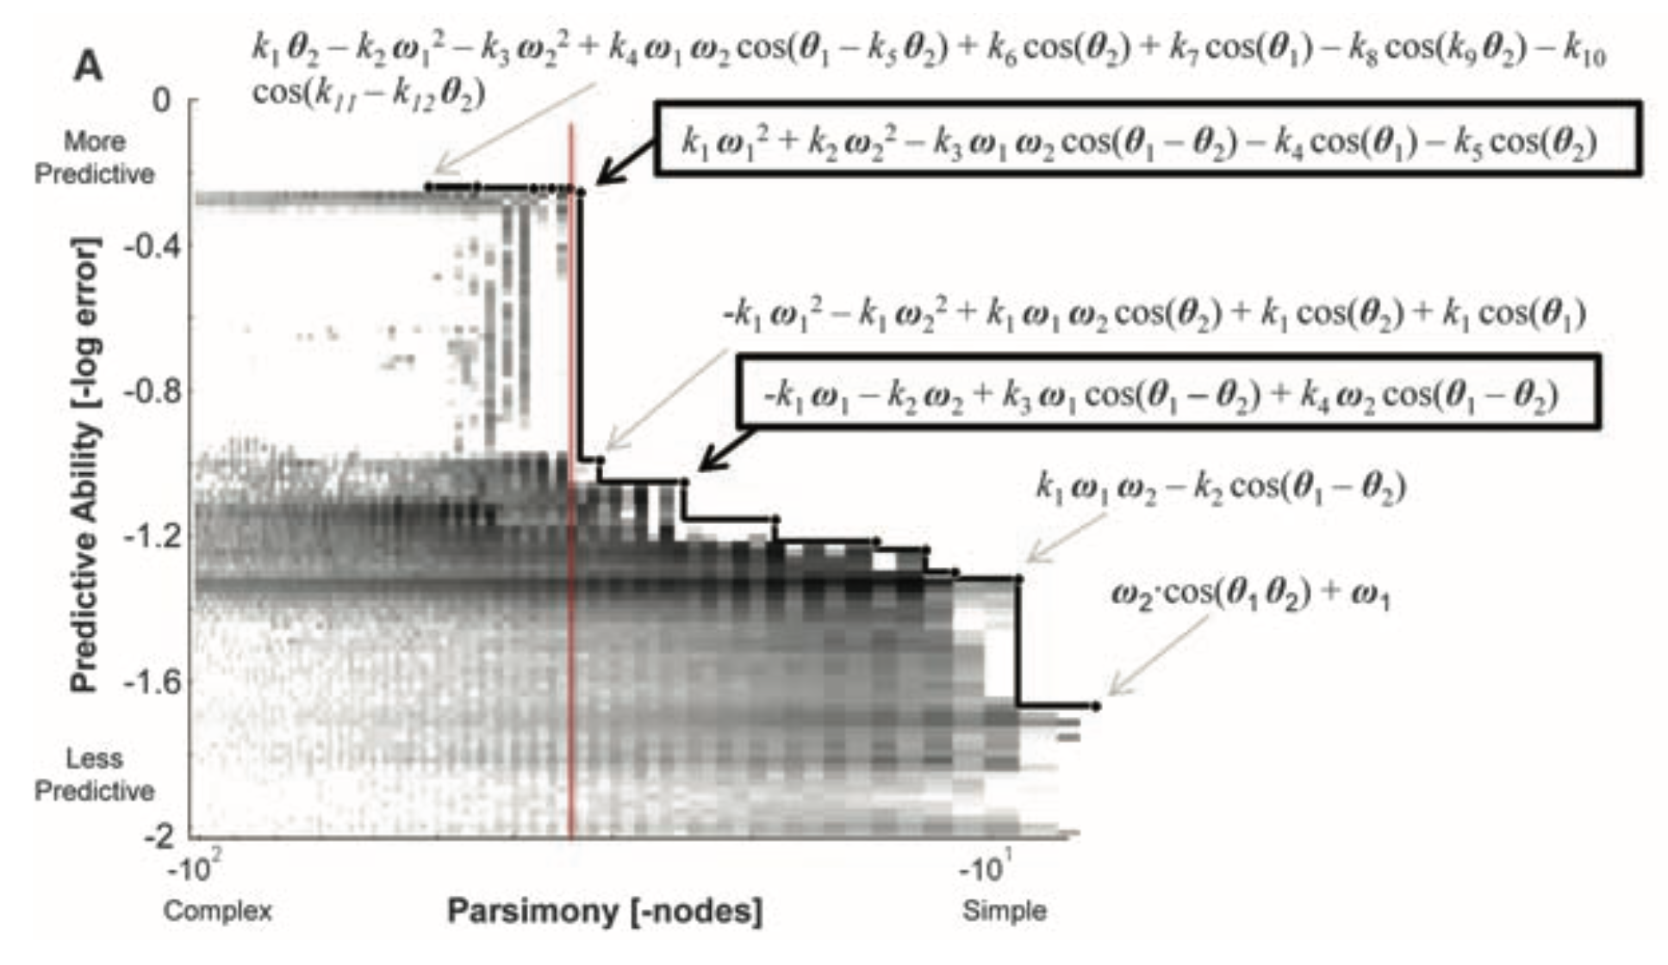
Using Symbolic Regression to Analyse Plasma Data
How PySR works:
PySR is a Symbolic Regression library — a regression that uses any unary or binary operators and returns the best fit it finds with those operators.
PySR is a multi-population evolutionary algorithm trained by “natural” selection (minimising the loss). The different populations also interact with exchanges of branches, enabling the fit to surpass any local minima.
The algorithm, then, chooses the equation based on a the log-loss complexity curve, meaning a lower complexity may be chosen even with a higher loss.

Slide 2
How PySR actually works
To understand how to work with the library, I first did a scan with the main parameters PySR uses:
Seed
For a practical number of iterations (<100) there is a high dependency on the chosen seed.
Error
PySR has no problem dealing with small errors ($≤$ 1%). With denoise = True we can deal with higher errors ($≤$ 10%)
Iterations and populations
A good number os populations is 2x or 3x the amount of cores available. Of course the amount of Iterations will improve the fit,
usually until a certain point. What I like to do is set the iterations to 10.000.000 and set a maximum amount of time (e.g. 2 hours)
Number of points
A good amount of data is 1000 points. For less data the algorithm can also perform well but not as good. If the data is much
larger than 1000 it can be a good idea to divide the dataset in sets of data with 1000 points (to run in parallel and to have more
populations)

Slide 3
Next steps
Next I intend to analyse different waves in plasma with data created from ZPIC.
This gives us a hierarchy of expressions to analyse with PySR and check PySR’s utility in analysing real data.
For this I intend to try to find the equations for 5 different seeds.
ZPIC equation
Correct Solutions
n
Plasma Oscillations
$$ω^{2}=1+0.0027k^{2}$$
/
5
n
Ordinary Waves
$$ω=\sqrt{1+k^{2}}$$
/
5
Right Waves
$$k^{2}=ω^{2}-\frac{ω}{ω-2}$$
n
/
5
Left Waves
$$k^{2}=ω^{2}-\frac{ω}{ω+2}$$
n
/
5
$$ω_{±}=\frac{k^{2}+3±\sqrt{k^{4}-2k^{2}+5}}{2}$$
n
Extraordinary waves
/
5

